Slide 1
Image Correctness for a Product on Marketplace
CSE7101- Capstone Project
Review-1
Batch Number: CIT_51
Roll Number | Student Name
Under the Supervision of,
Ms. Soumya
Professor / Associate Professor / Assistant Professor
School of Computer Science and Engineering
Presidency University
20221CIT0003 | Vikas Yadav
20221CIT0005 | Shaik Yasin Shahid
20221CIT0033 | Akhil Hari
Name of the Program: B.Tech(Computer Science And Engineering)
Name of the HoD: DR. Anandaraj S P
Name of the Program Project Coordinator: Refer- Annexure-1
Name of the School Project Coordinators: Dr. Sampath A K , Dr. Geetha A

Slide 2
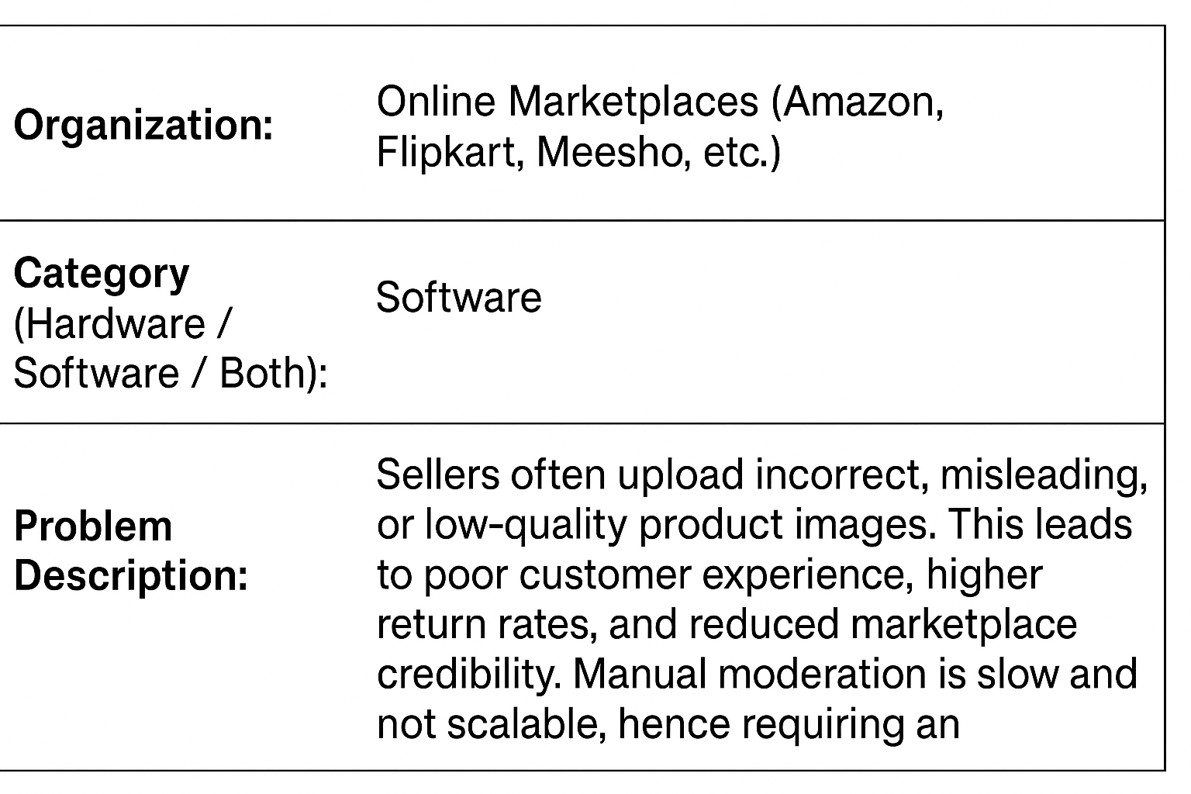
Problem Statement Number: PSCS_52

Slide 3
Content
Problem Statement:
In online marketplaces like Amazon, Flipkart, or Meesho, sellers often upload product images that are incorrect, misleading, of low quality, or irrelevant. This leads to: Poor customer experience return rates, Loss of platform credibility. Manual moderation is time-consuming and not scalable. Hence, there is a need for an automated system that can verify the correctness and quality of images before they are published.

Slide 4
Content
Objectives:
To develop an AI-powered system that automatically verifies whether the uploaded product image is:
Relevant to the product listing
Meets marketplace quality standards
Free from policy violations (e.g., watermarks, irrelevant text, multiple objects)

Slide 5
Content
Features of the Proposed System:
Image Relevance Check: Detect if the image content matches the product title and description.
Background Validation: Check for white or plain background (as per marketplace standards).
Single vs. Multiple Product Detection: Ensure only one product is in focus unless bundles are listed.
Text and Watermark Detection: Detect brand logos, promotional content, or text that violates platform rules.
Image Quality Checks: Verify clarity, resolution, brightness, and cropping.
Duplicate Image Detection: Prevent sellers from reusing the same image for different products.

Slide 6
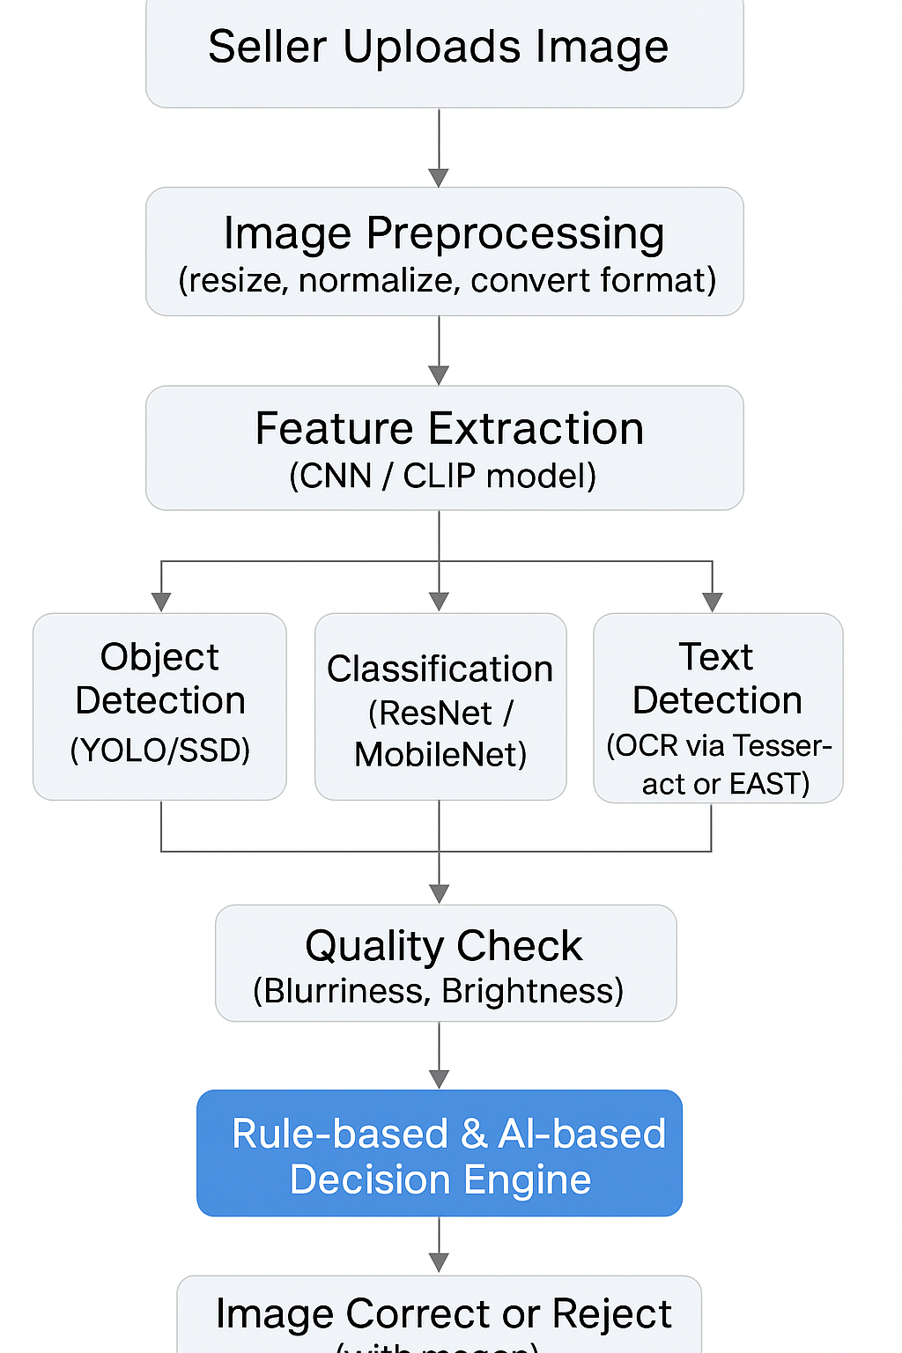
Content
System Architecture:

Slide 7
Content
Tools and Technologies :
Category Technology | Tool
Language | Python
Frameworks | TensorFlow, PyTorch, OpenCV
Pre-trained Models | CLIP, MobileNet, YOLOv5
OCR | Tesseract, Google Vision API
Backend Flask | Django
Database | MongoDB / PostgreSQL
Frontend | React.js or HTML/CSS (if UI needed)
Deployment | AWS / Heroku / GCP

Slide 8
Content
Methodology:
Data Collection:
Gather a dataset of product images, labeled as correct or incorrect.
Include multiple categories: fashion, electronics, groceries, etc.
Preprocessing:
Resize, normalise, remove noise.
Model Training:
Train CNN for category-specific image classification.
Use YOLO for object detection and bounding box generation.

Slide 9
Content
Text Detection and Removal:
Use OCR to detect any embedded text or watermark.
Flag if policy-violating text is found.
Rule Engine:
Set validation rules (e.g., no multiple items, minimum brightness, correct aspect ratio).
Combine rule-based + AI model scores to accept/reject the image.
Evaluation Metrics:
Accuracy, Precision, Recall
False Positive Rate (e.g., wrongly rejected good image)
F1 Score

Slide 10
Content
Challenges:
Challenges | Details
Variability in Image Types | Multiple product categories may need custom image rules
Presence of Multi-Objects | Images may contain accessories or multiple products (bundled offers)
Handling Watermarks/Logos | Detecting brand-specific or faint watermarks can be difficult
Language and Text Variability | OCR must detect text in multiple languages/fonts
Generalization of Model | Avoid overfitting to a few product types; ensure it works across categories
False Positives/Negatives | A balance is needed; shouldn't wrongly reject valid images

Slide 11
Content
Expected Outcomes:
90%+ accuracy in detecting incorrect or low-quality images
Drastic reduction in manual moderation time
Enhanced trust among buyers due to higher image reliability
Higher approval rate of seller products on first upload
Lower product return rates

Slide 12
Content
Future Enhancements:
Include multimodal analysis (text + image matching using CLIP).
Add real-time feedback to sellers during upload.
Introduce explainability (e.g., “Image rejected because it contains multiple items”).

Slide 13
Analysis of Problem Statement
Problem Description:
Poor Customer Experience: Buyers may be misled or get an inaccurate impression of the product.
Increased Return Rates: Misleading images can lead to customers returning products more frequently.
Loss of Platform Credibility: The trustworthiness of the marketplace diminishes when product listings are inaccurate.
Inefficient Moderation: The existing method of manual moderation to catch these issues is time-consuming and not scalable for large platforms.

Slide 14
Analysis of Problem Statement (contd...)
Objectives: The specific goals of the project.
Features of the Proposed System: The planned capabilities like background validation or watermark detection.
System Architecture: The technical workflow from image upload to decision.
Tools and Technologies: The specific software, frameworks, and models to be used.
Methodology: The steps for data collection, model training, and evaluation.
Expected Outcomes: The anticipated results, such as accuracy levels and impact.
Future Enhancements: Planned improvements after the core project is complete.

Slide 15
Github Link
The Github link provided should have public access permission.
Github Link

Slide 16
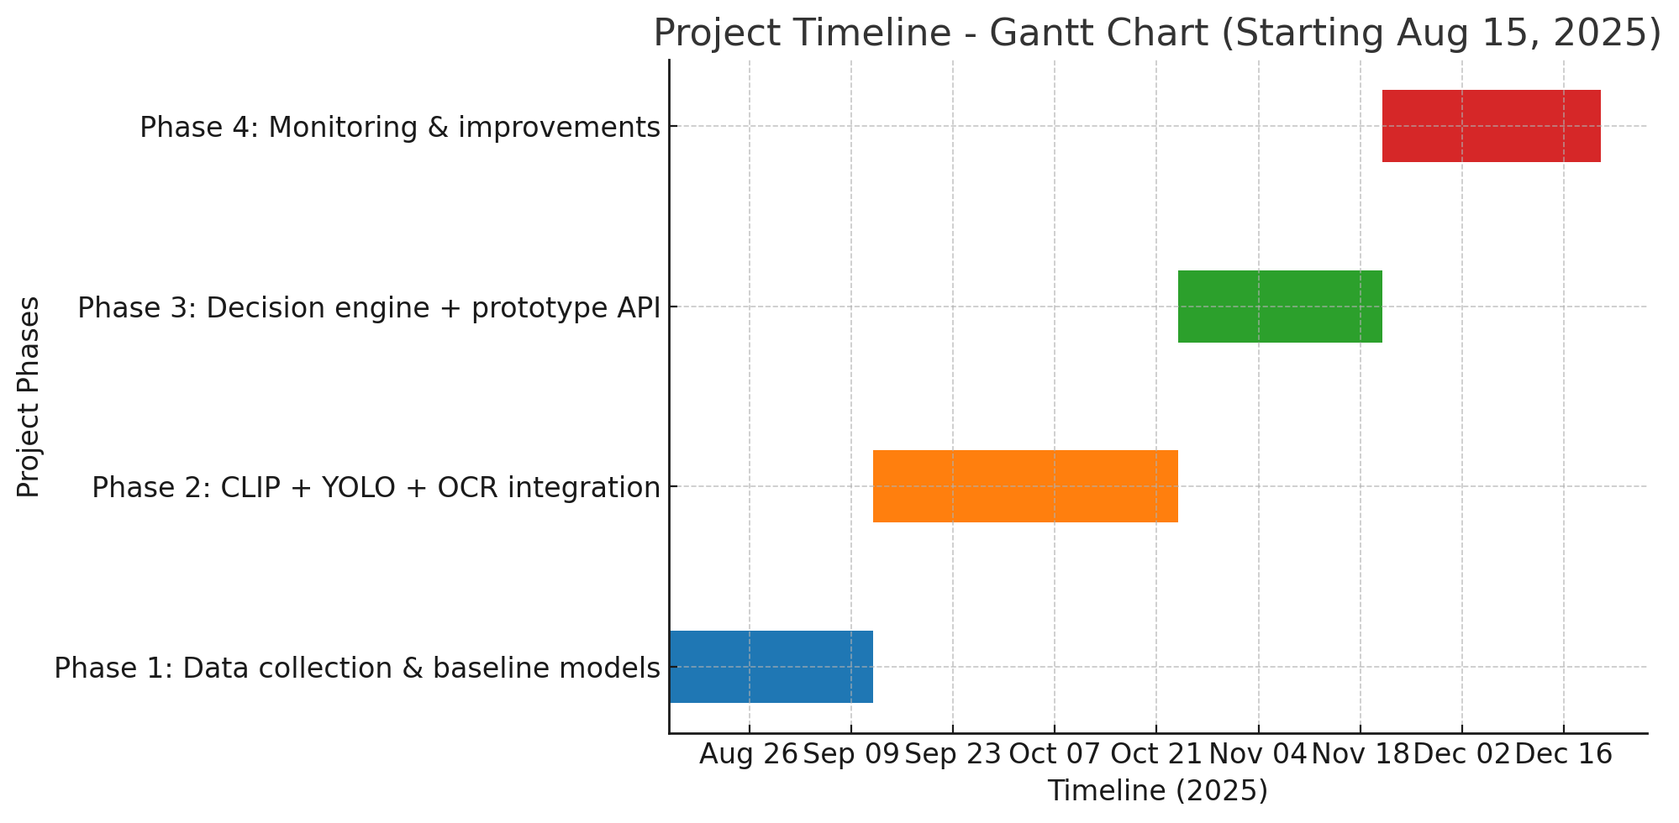
Timeline of the Project (Gantt Chart)

Slide 17
References (IEEE Paper format)
A. Krizhevsky, I. Sutskever, and G. E. Hinton, “ImageNet classification with deep convolutional neural networks,” Communications of the ACM, vol. 60, no. 6, pp. 84–90, Jun. 2017.
J. Redmon and A. Farhadi, “YOLOv3: An Incremental Improvement,” arXiv preprint arXiv:1804.02767, Apr. 2018.3.
A. Dosovitskiy et al., “An Image is Worth 16x16 Words: Transformers for Image Recognition at Scale,” arXiv preprint arXiv:2010.11929, Oct. 2020.4.
A. Radford et al., “Learning transferable visual models from natural language supervision,” in Proceedings of the International Conference on Machine Learning (ICML), 2021, pp. 8748–8763.

Slide 18


